Slide 1
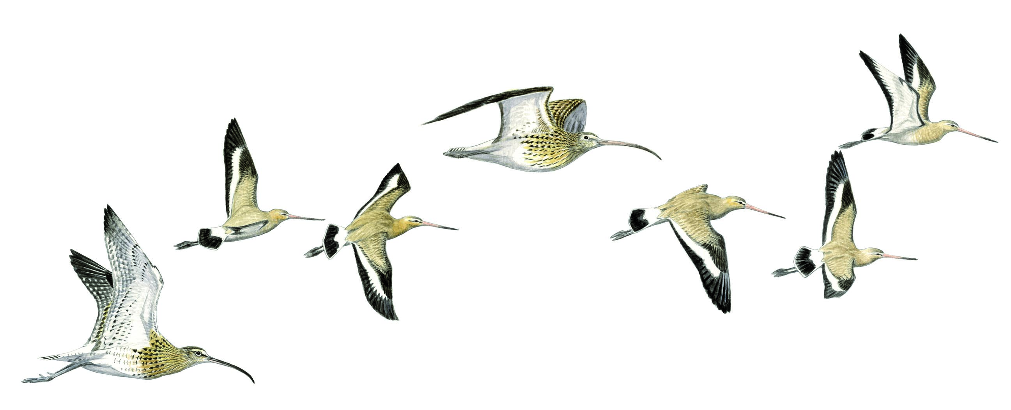
– Module 8 –
From counting to monitoring
Identifying and Counting Waterbirds in Africa
– Training Course –
2015
Notes:
This module is part of Hecker N., 2015. Identifying and Counting Waterbirds in Africa: A toolkit for trainers. ONCFS, Hirundo-FT2E. France.
This PowerPoint presentation does not include any personalised activities. Trainers can therefore add activities to suit their needs.
Module adaptation
The trainer is invited to adapt the module content to specific needs and to the national context. He or she might adapt:
According to the level of the trainees, their prior experience in waterbird census, and their roles in National and International Waterbird Census;
According to the availability of technical means (e.g. Internet connection, computers, smartphones, etc.);
In order to show national examples: site list, counted sites, recording forms and outputs, etc.

Slide 2

This module is part of Hecker N., 2015. Identifying and Counting Waterbirds in Africa: A toolkit for trainers. ONCFS, Hirundo-FT2E. France.
Designed in 2015 by:
Szabolcs Nagy Szabolcs.Nagy@wetlands.org
Clémence Deschamps deschamps@tourduvalat.org
Illustration (first slide):
Cyril Girard girardcyril3335@neuf.fr, www.cyrilgirard.fr
Notes:
This entire publication (text, photos and illustrations) is licensed by Creative Commons CC BY-NC-SA.
Any part of this publication may be copied, used, adapted and distributed for non-commercial purposes, citing the authors’ names and distributing any material produced from this publication under identical or similar licence.

Slide 3
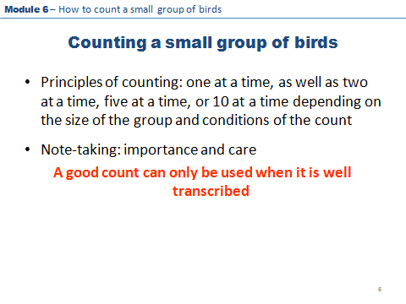
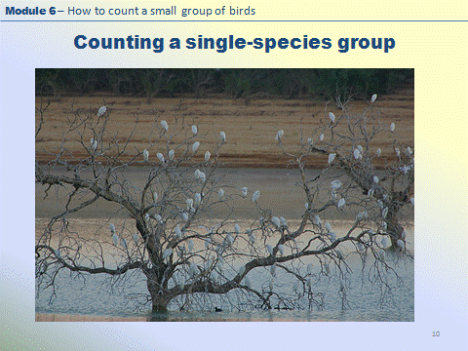
Presenting the Module
Technical explanations
Indoor exercises
Notes:
Module 8 includes different types of slides:
White background: technical explanations;
Shaded blue / yellow background: indoor exercises.

Slide 4
In this module
You will learn:
What is monitoring?
How to cover sites systematically?
What information to record?
How to report your observations?
How your data help waterbird conservation?
Notes:
This Module should motivate each trainee to collect data systematically and regularly. This Module builds on Module 4 – Why count waterbirds?
The essential point of this module is that trainees understand how counting waterbirds relates to surveys, surveillance and monitoring.
Trainer’s role:
To help the trainees understanding key concepts;
To show examples;
To inform trainees about the “big picture”.
Trainer’s skills:
A sound knowledge of data recording and management processes at national and international level;
A knowledge of key outputs from waterbird monitoring at national and international level;
Ideally, this subject is introduced by the national IWC coordinator, if there is any already in the country.

Slide 5
What is monitoring?
Survey is a method of data collection which provides a framework for systematic measurement of variables
Surveillance is a systematic measurement of variables over time with the aim of producing time-series data
Monitoring refers to the measurement of variables over time in a systematic way with specific objectives in mind
Notes:
Trainer’s role:
To explain the difference between survey, surveillance, and monitoring;
To introduce these terms and highlight the differences between them;
To emphasize:
The need for systematic measurement of variables (e.g. bird numbers). This is where all of these activities differ from birdwatching;
The progression from one-off surveys through surveillance to monitoring which compares the results to a set target.

Slide 6
What is monitoring?
Indoor exercise: What does systematic mean?
Using the same method of counting or estimating
Using the same or similar equipment
Visiting and spending roughly the same time at the site
Using the same means of transport during a count (boat, plane, ground)
Covering the same area at the same time of the year
Following the same route
Stopping at the same points to count
Why is it a problem if you change any of these?
Is « systematic error » a problem?
Notes:
Indoor exercise
Equipment: Flipchart and/or this slide
Procedure: Entire group
The trainer should start by explaining that, in order to produce comparable results over time that reflect real changes in waterbird populations, we need to minimise the differences caused by changing the way the count is conducted.
The procedure depends on the prior experience of the group:
If some participants have already taken part in waterbird monitoring activities, then the trainer can simply encourage the group to brainstorm on factors that should be the same during repeated counts, record them on a flipchart and discuss with the group why it is a problem if a given factor is changed.
If the group has no prior experience with waterbird counting, it is better to show the list on the left and initiate a discussion on the theme “why is it a problem if you change any of these?”.
Finally, a short discussion can be conducted on whether a “systematic error” (the same error repeated at each count) is a problem and if so, when?
Trainer’s role:
To help with the thought process and discussion;
To highlight how each of the sentences can be linked to the definitions on the previous slide.

Slide 7
Indoor exercise: Which of these are survey, surveillance or monitoring?
What is monitoring?
You go out counting in a remote part of your country and you record some of the waterbirds you have seen.
You go to count birds in a remote corner of the country, you record the area you covered and record all your observations on a standard data sheet.
You participate in the International Waterbird Census every year counting different sections of the coast and you record your observations on a standard data sheet.
You participate in the International Waterbird Census every year counting the same section of a lake, at the same time of the day and you record your observations on a standard data sheet.
You do as above, but with the objective to determine how waterbird populations are changing to inform their management.
Notes:
Indoor exercise
Equipment: This PowerPoint slide
Procedure: Entire group
The trainer shows the first example and asks the group whether the sentence describes a survey, surveillance or monitoring;
Someone from the group gives an answer and the group discusses why the answer was correct or incorrect comparing it back to the previous slide;
Repeat steps 1-2 for sentences 2-3.
Sentence 1: this is just birdwatching and not even a survey, because it is not exactly clear what is the extent of the area counted and only an incomplete list is made.
Sentence 2: this is survey because it is systematic, but does not produce time-related data.
Sentence 3: this is still a survey because it is systematic, but counting different areas. Hence, it does not produce time related data.
Sentence 4: this is surveillance because it is systematic and repeated (i.e. produces time-related data).
Sentence 5: this is monitoring because it has an objective. The trainer can explain that the objective can be a certain number (i.e. a target) that the management aims to support at the site (e.g. a certain number exceeding the 1% threshold of a species because the site was designated as a Ramsar site).
Trainer’s role:
To help with the thought process and discussion; and
To highlight how each of the sentences can be linked to the definitions on the previous slide.

Slide 8
What makes the International Waterbird census a monitoring programme?
Monitoring is a systematic measurement of variables over time with specific objectives.
The International Waterbird Census:
  Is a synchronised count of waterbirds
  Ideally covers the same areas in the same way, year after year
  Records bird numbers and a limited set of environmental data
  Aims to produce waterbird population size and trend estimates providing a comprehensive basis for management and decision making.
Notes:
Some strategic guidance documents are available for national coordinators:
Guidance on waterbird monitoring methodology: Field protocol for waterbird counting. http://www.wetlands.org/Portals/0/activeforums_Attach/Protocol_for_waterbird_counting_En.pdf
Guide méthodologique pour le suivi des oiseaux d'eau : Protocole de terrain pour le comptage des oiseaux d'eau. http://www.wetlands.org/LinkClick.aspx?fileticket=cQEmmRINQZ8%3d&tabid=2791&portalid=0&mid=14070
Some examples for strategic planning of monitoring frameworks are available in English from the Wadden Sea Flyway Initiative:
West Africa Monitoring Strategy: http://www.waddensea-secretariat.org/sites/default/files/downloads/west_africa_monitoring_strategy.pdf
Integrated monitoring of waterbirds along the East Atlantic Flyway: http://www.waddensea-secretariat.org/sites/default/files/downloads/flyway_monitoring_plan.pdf
Please see also Module 4 - Why count waterbirds?

Slide 9
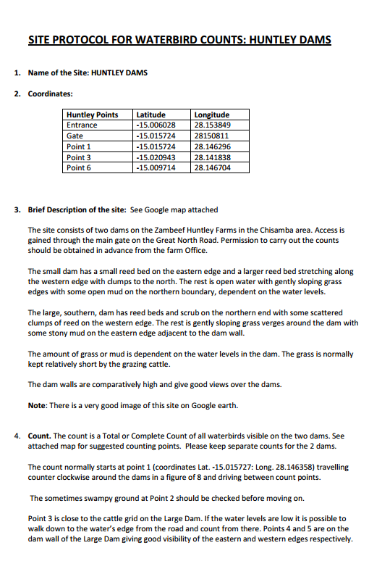
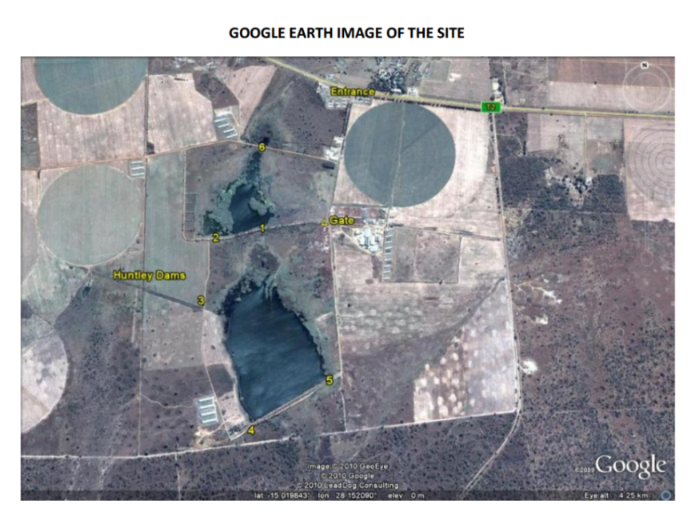
Waterbird Census preparation
Site protocol
A site protocol can be used for well known sites after gaining experience of how best to cover the site
It defines and records:
the standard transport method used to cover the site (e.g. on foot, by car, boat, plane or a combination of these)
the standard route to be followed
tidal conditions (e.g. high tide on mudflats, mid-tide on mangroves)
the standard lookout points
Site protocols are useful to establish continuity
Notes:
The trainer should explain that a site protocol :
Is defined by key elements;
Is mainly used for well known sites such as protected areas where they are feasible and replicable.

Slide 10
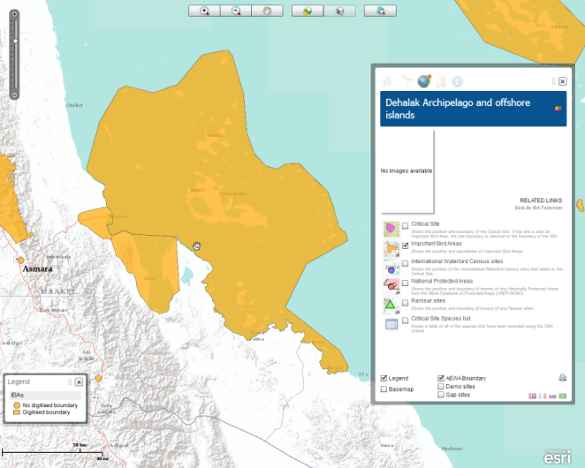
Waterbird Census preparation
Division of a site into count units
Sites, such as protected areas, Important Bird Areas and Key Biodiversity Areas, are often too large for one counting team to cover in reasonable time
We divide them into count units that can always be covered in a similar way
Count units include a number of observation points, transects, etc.
> 100 km
Notes:
The following slides explain how to organise counting activities at the site level.
The key point here for the trainees is to realise that “sites” are often too large for one team to count and to deal with, this is the reason why they are divided into count units.
As a general advice, the trainer can suggest that a count unit should be not larger than what the team can cover in c. 4 hours.
He or she can either explain or challenge the group to discuss why this scale is appropriate. Reasons include:
Something may go wrong (car/boat engine can break down, bad weather, etc.)
Observers get too tired
Monitoring needs to be feasible, sustainable and replicable
At a national level, collaboration with the IBA monitoring process is recommended.
Further information on IBA monitoring can be found at http://www.birdlife.org/datazone/info/ibamonitoring and at the bottom of the page there is a link to a detailed guidelines.

Slide 11
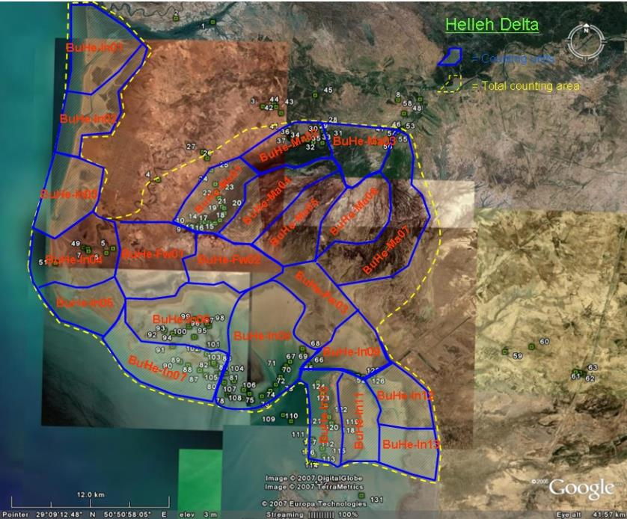
Waterbird Census preparation
Division of a site into count units
The definition of count units should reflect
  the Hydrological regime (e.g. tide, flood, etc.)
  Accessibility
  Visibility
  Method of transport
Notes:
Trainer’s role:
To demonstrate and explain an example of dividing a large site into count units and provide a list of factors to consider when defining count units. Blue lines show count units, green dots represent vantage points. Note that not all count units have vantage points because not all count units are counted due to limited capacity;
To emphasize the relationship between method of transport and accessibility e.g. in case of floodplains.;
To emphasize that, in many cases, there will not be enough teams to cover each count unit during the mid-winter census. In such cases, trainees are advised to select a number of count units that can be covered every year with the existing capacity;
To initiate a discussion why it wouldn't be good to cover different count units in different years.

Slide 12
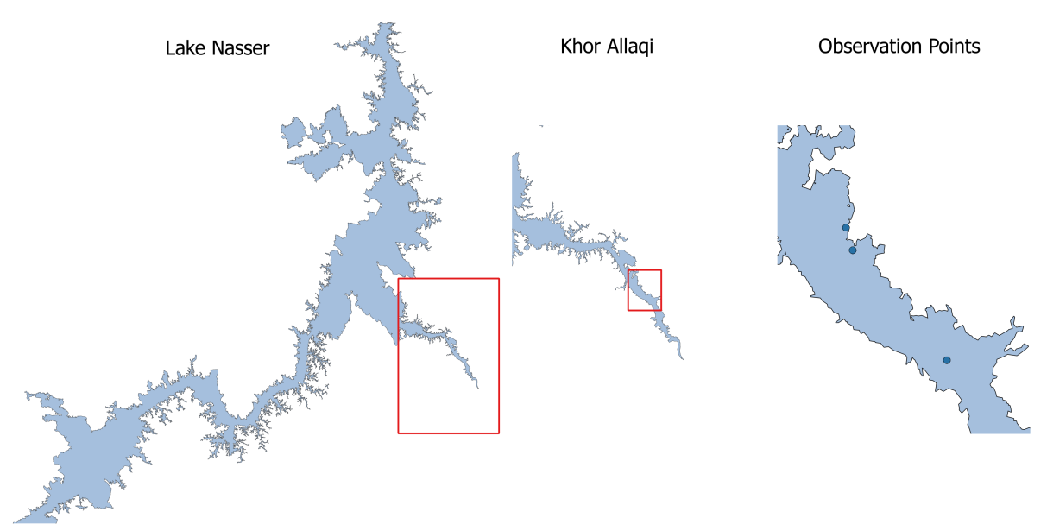
Waterbird Census preparation
Division of a site into count units
Example of division levels
Parent site: Nasser Lake
Site: Khor Allaqi
Count units: Sections, transects
Observation points
For feasible & replicable monitoring
Notes:
The trainer will show and explain an example of division levels.
A biogeographical unit / Parent site: includes a number of sites
A site: includes a number of count units
A count unit: includes a number of observation/counting points
An observation point

Slide 13
Waterbird Census preparation
Documenting counted sites and counted units
Which data ?
Site code
  Wetlands International site code, if already counted and counts provided to WI
  National site code if available
Site Name
Parent site Name
Region
Latitude (Y) : in decimal degrees in WGS84
Longitude (X) : in decimal degrees in WGS84
An agreed national site list is necessary
Notes:
Trainer’s role:
To explain which data are collected about the site;
To explain what is the role and importance of an agreed national site list. The number of sites in the country and which sites are important for the waterbirds (species diversity, numbers) are important to know in order to define a minimum sites list to count every year (for example : if you count x sites, you will cover 50% of the waterbird population in the country)

Slide 14
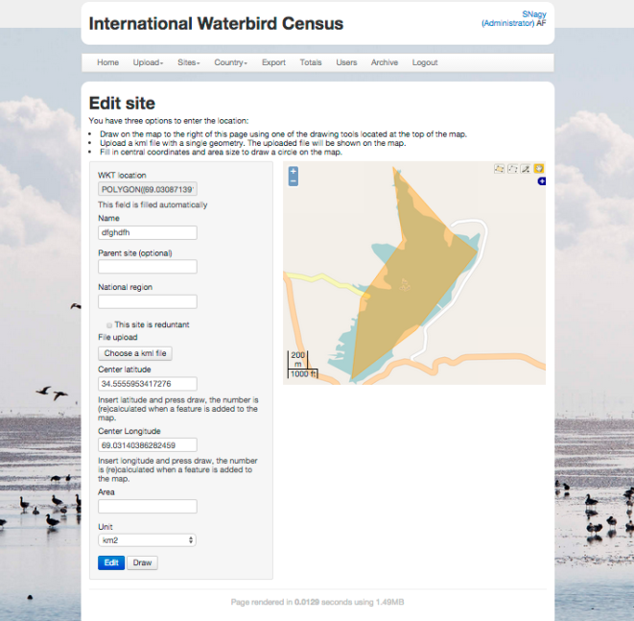
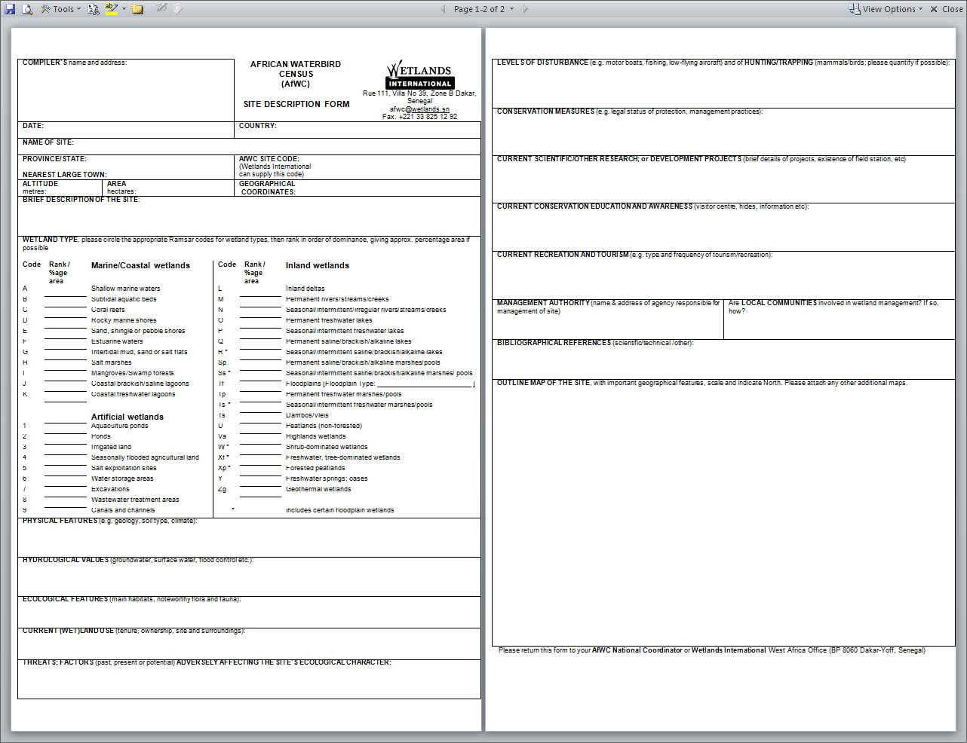
Waterbird Census preparation
Documenting counted sites and counted units
Which format?
Online database
Information easy to share
Needs a good Internet connection
Digital site boundaries
Site forms
The simplest way to document sites
Information difficult to share
Notes:
The trainer will explain the different formats. He or she will adapt explanations according to the experience of trainees.
National coordinators are in the best position to consider how and what information to record at a national level.
Traditionally there were so called Site Forms that contained information about the ecological character, land use and threats to the site together with a map.
Nowadays, online databases are more and more common but they need a good Internet connection.
IWC Online database: Each new site has to be entered into the database in order to be able to submit observations for the area and to inform the data analysis process.
Digital site boundaries:
The trainer will decide whether it is relevant to develop this subject depending on the experience, role and responsibility of trainees in the waterbird census.
There is a number of existing methods:
Google earth
GIS : QGIS (free open source), Arc GIS
Remote sensing (NDVI).
A guidance document on digitising site boundaries is available at:
http://www.wetlands.org/LinkClick.aspx?fileticket=-j6Y3P27ymE%3d&tabid=2791&portalid=0&mid=11794 in English
http://www.wetlands.org/LinkClick.aspx?fileticket=eRkyqHXv5h8%3d&tabid=2791&portalid=0&mid=14070 in French.

Slide 15
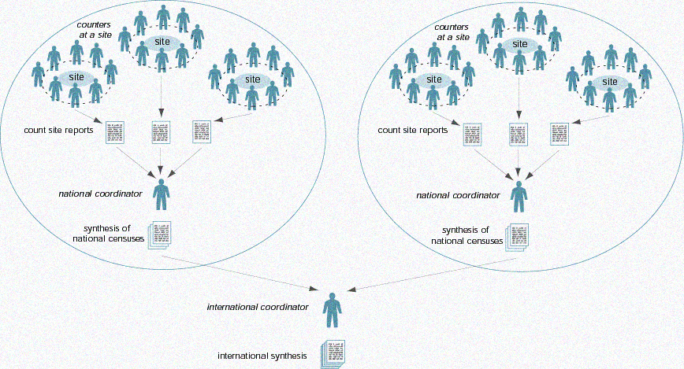
Waterbird Census Data Flow
Indoor exercise
Notes:
Indoor exercise: Diagram of networks
Procedure:
The “How a waterbird monitoring network works” factsheet S4.2 should be handed out to each trainee at the beginning of the exercise.
All trainees should take part in a discussion of the following points:
the role of each person (counters, national and international coordinators);
the results at each level, their distribution and use;
the links between each level (arrows) and the importance of each one.
Trainer’s role:
To lead the discussion and see that everyone participates;
To make the connection with the results from the previous exercise clear.

Slide 16
Waterbird Census Data Flow
Key steps
Step 1: Observers taking notes in the field
Step 2: Observers submit their data to the national coordinator
Step 3: National coordinators compile data and make a first check of the data, then send it to WI
Step 4: Wetlands International produces international overviews
Notes:
The trainer will present the 4 key steps of the data flow.

Slide 17
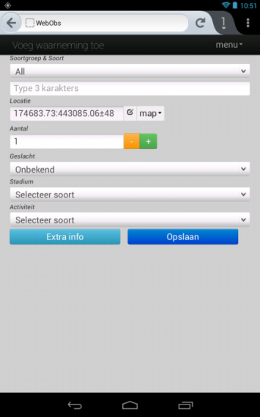
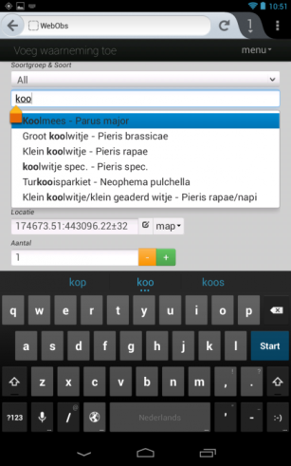

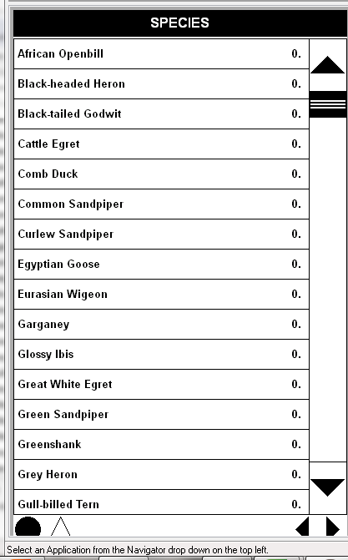
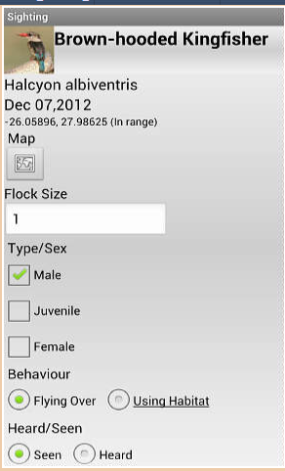
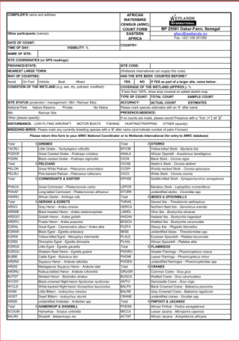
Waterbird Census Data Flow
Step 1: Observers taking notes in the field
Tools for data recording
Mobile applications:
  WebObs, ObsMap,
  Cybertracker , BirdLog, Gbird, …
Notepad
Recording sheet
Dictaphone
Notes:
The trainer will present tools for data recording in the field.
The trainer will emphasize that there are various ways of recording data during the count, with different pros (+) and cons (-) :
Simple notepad : (+) easy to use, (indelible ink is needed); (-) unstructured;
Recording sheet : (+) more structured (helps to remember to record important things), larger, best used when there is a counter and a note taker, (indelible ink is needed);
Various smart phone applications: (+) Data can be easily uploaded to websites without re-entering again, some allow users to design and customize applications to their own needs. (-) need a smart phone, battery may get flat during the counts, smartphone may fall in the water…
Dictaphone : (+) fast, does not distract from observations, Most useful when counting mixed flocks alone ; (-) observer may fail to record something or may be unable to hear recording because of background noise (e.g. wind), may fall in the water…, slow to transcribe.
Mobile applications: WebObs, ObsMap (connected to observation.org), BirdLog, Gbird, Cybertracker (not connected to observation.org).
The trainer may invite the group to discuss the advantages and disadvantages of each.

Slide 18
Waterbird Census Data Flow
Step 1: Observers taking notes in the field
Key information
Time When (date & time)
Site Where (GPS point, site name, etc.)
Participants Who (observers/organisation involved)
Method How (by boat, foot, plane …)
Birds What (species name)
How many (total number per species)
Notes:
The trainer will present the main information types to be recorded in the field.

Slide 19
Waterbird Census Data Flow
Step 1: Observers taking notes in the field
Detailed information requested in the reporting form will be recorded
It includes:
Location data.
Date and time
Coverage of the count unit
Water conditions of the wetland
Tide conditions
Weather
Disturbance
Method of transport
Optics
Observers
Comments on threats and conservation actions
Species
Numbers counted
Count method
Notes:
It is important that the observers record all the information that is required for international purposes.
This information is necessary for data analysis.
It includes:
Location data: It is important to emphasise that more detailed documentation is needed for new sites than for existing ones with an existing site protocol;
Date and time;
Coverage of the count unit (important to indicate if the count was incomplete);
Water conditions: normal, flooded, dry;
Tide conditions;
Weather: whether it affected the count results;
Disturbance: whether it affected the count results;
Method of transport;
Optics: whether binoculars or telescopes were used;
Observers;
Comments on threats and conservation actions;
Species (and subspecies if known) – use multispecies codes only if it is impossible to identify large number of birds;
Numbers counted (also by age and/or sex if possible) – important for demographic monitoring;
Count method: i.e. real count, estimate or extrapolation from samples.

Slide 20
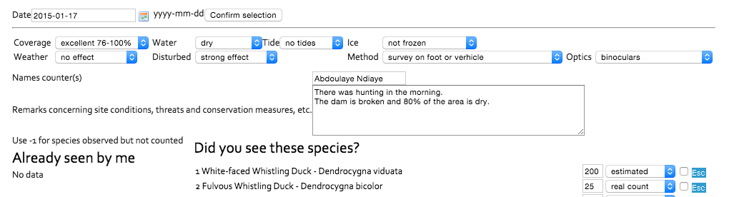
Waterbird Census Data Flow
Step 1: Observers taking notes in the field
Detailed information
Example: Location
Site, count unit – use the standard site names and count unit definitions
provided by the national coordinator
If the site has not previously been counted, record:
Region, district, nearest settlement
Central coordinates in WGS84 (in case of rivers, the coordinate of the
central section of the area counted)
GPS track of the route and vantage points
Notes:
The trainer will present detailed information (and might include new slides according to the level of detail needed).

Slide 21
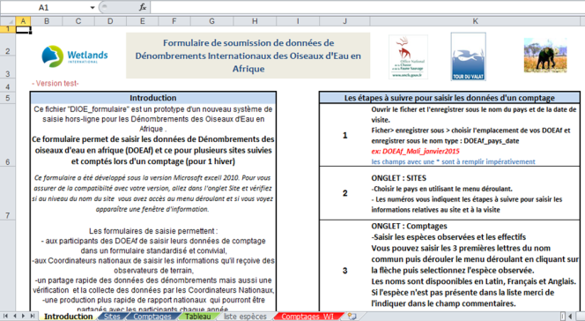
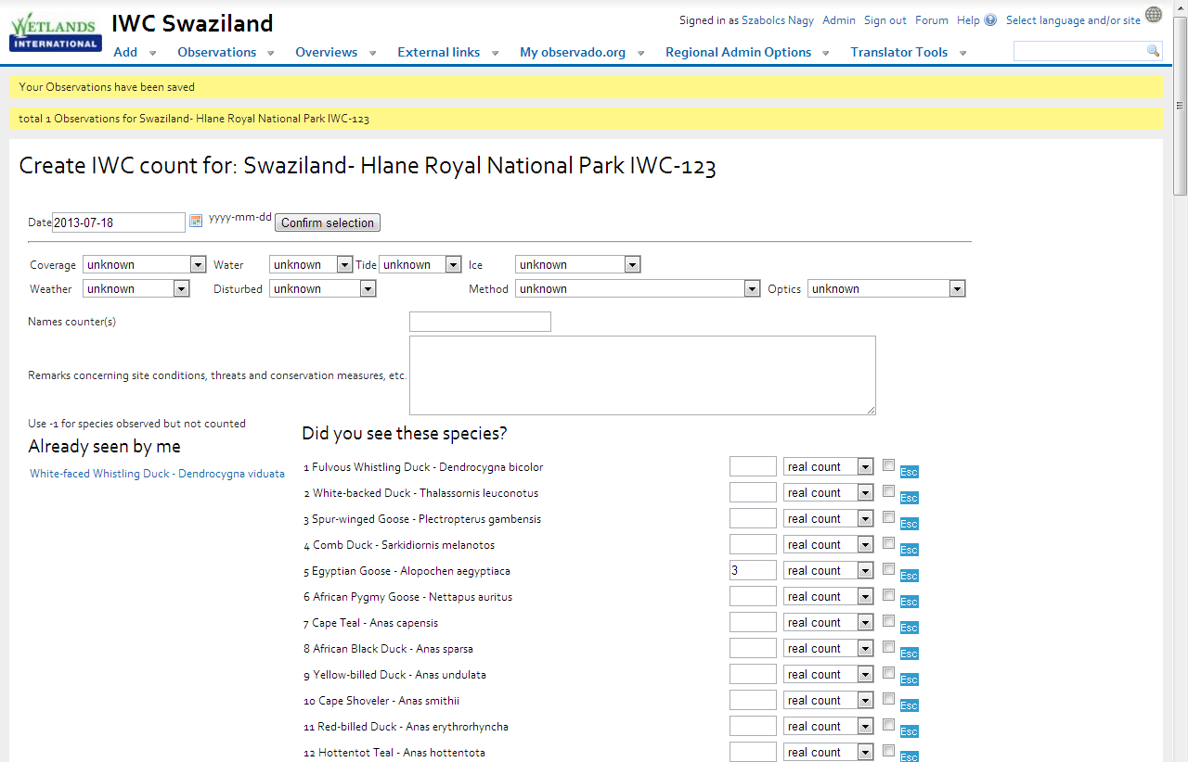
Data submission to the national coordinator under the format agreed upon at national level
Waterbird Census Data Flow
Step 2: Observers submit their data
Submission form
(Excel, paper count form)
Internet: e.g. IWC form on Observation.org, CWAC, etc.
Send Paper form or Excel submission form directly to your National Coordinator
Record/upload it to an online platform or national scheme used in your country
Notes:
The trainer will present the next step in the process: the observers submit their observations to the national coordinator.
This is done traditionally through paper, Word or Excel count forms.
Recently, an increasing number of countries have used online forms mainly in Western European countries, but also in South Africa.
However, usually it is expensive to develop these. Therefore, Wetlands International has collaborated with the Nature Information Foundation and adapted their Observado.org system to the needs of the IWC.
There is special IWC entry form that follows the logic of the paper form.
Guidance documents are available how to set up the Observation.org system for IWC counts and can be found at:
http://www.wetlands.org/LinkClick.aspx?fileticket=M6dC6-bcPcA%3d&tabid=2791&portalid=0&mid=11794 in English
http://www.wetlands.org/LinkClick.aspx?fileticket=UM90eb_L9Eo%3d&tabid=2791&portalid=0&mid=14070 in French

Slide 22
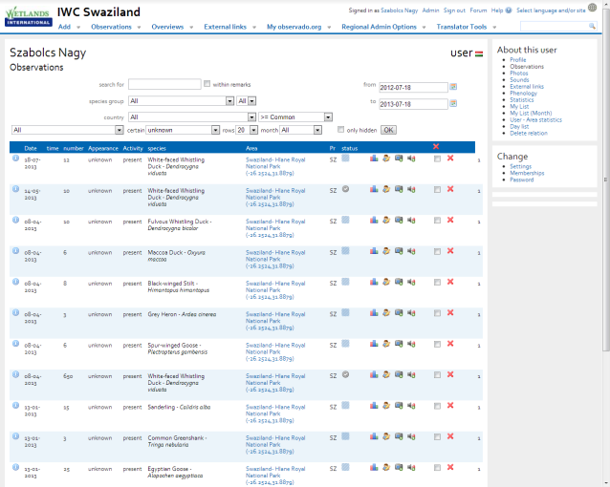
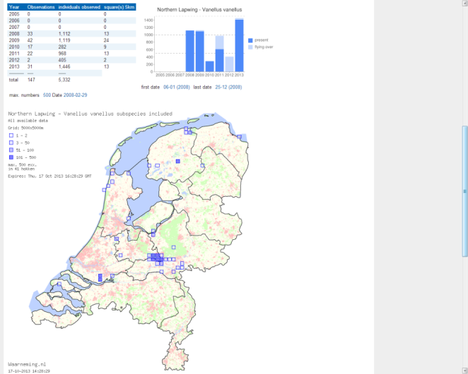
Advantages and disadvantages of using an online database
Waterbird Census Data Flow
Step 2: Observers submit their data
Data need to be entered only once
Easier to retrieve data and to produce overviews
Data can be exported to other applications
Easy to share with others (building a community)
BUT needs technical means and knowledge as well as a good Internet connection
Notes:
The trainer will explain the advantages and disadvantages of using an on-line system.
However, this is not possible in countries without good and widespread Internet.
Nevertheless, Internet access is developing fast and it is worth planning for.

Slide 23

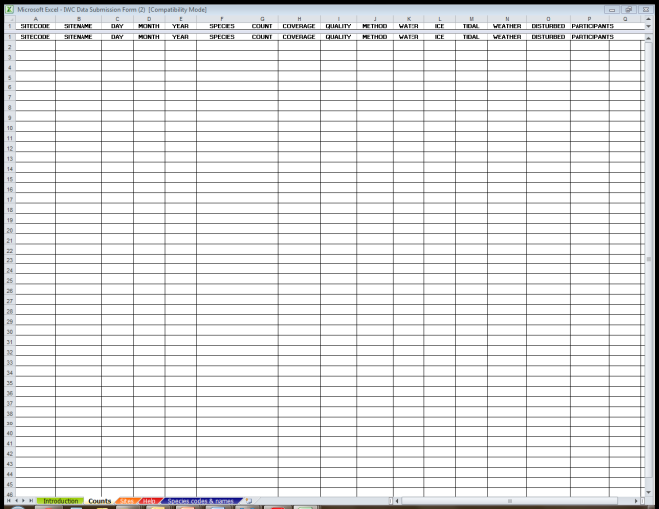
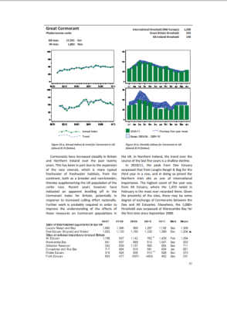
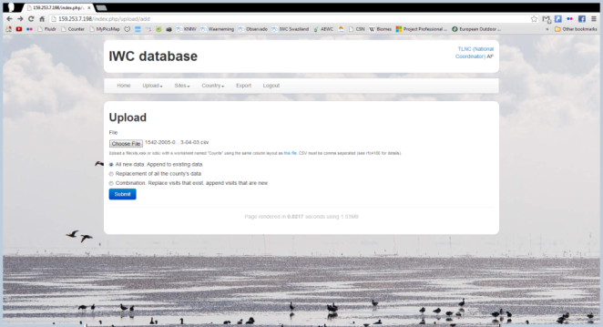
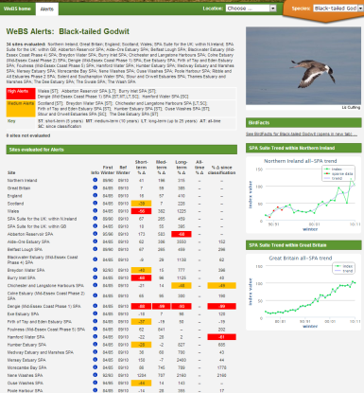
Waterbird Census Data Flow
Step 3: National coordinators compile data
Produce national reports
Submit national dataset to Wetlands International
Notes:
The trainer will explain that an important role of the national coordinators is to produce national reports that produce feedback to the observer network and to decision-makers responsible for conservation and sustainable management of waterbirds and their habitats.
The example is from the UK Wetlands Birds Survey (WeBS) to illustrate the potential scope of such reports. Reports can show trends of certain species, but can also highlight sites (red and amber cells) where a certain species is below target values.
Examples of national reports are available at:
http://www.wetlands.org/OurWork/Biodiversity/WaterbirdForums/tabid/2582/afv/topicsview/aff/93/Default.aspx
Another important role for the national coordinators is to submit their data to Wetlands International in order to feed into international assessments. Wetlands International and SOVON developed the IWC Online database where national coordinators can upload their data using a standard Excel file. They can also update, correct and retrieve their own data or can share it with neighboring countries.
The IWC Data Submission Form can be downloaded
in English at: http://www.wetlands.org/LinkClick.aspx?fileticket=D6bnaKIiDyQ%3d&tabid=2791&portalid=0&mid=11794
in French at: http://www.wetlands.org/LinkClick.aspx?fileticket=L1_tu4-icQM%3d&tabid=2791&portalid=0&mid=14070
A manual for the IWC Online database is available in English at:
http://www.wetlands.org/LinkClick.aspx?fileticket=tvrJOptSvGA%3d&tabid=2791&portalid=0&mid=11794

Slide 24
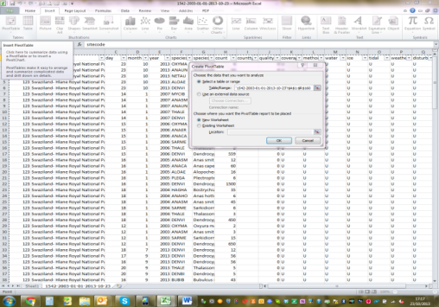
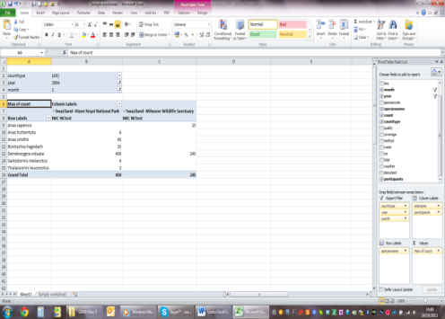
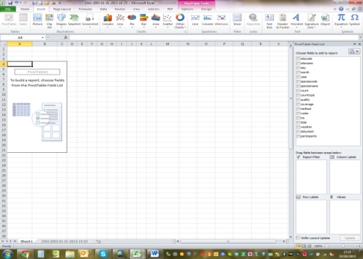
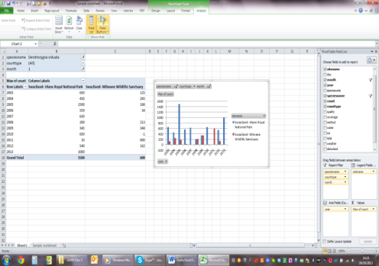
Excel PivotTable for fast and easy data analysis
Waterbird Census Data Flow
Step 3: National coordinators compile data
Notes:
This slide is to illustrate that the data in the structure of the IWC Data Submission Form (i.e. new data entered into that form or old data downloaded from the IWC Online or Observado.org) can be very easily used to produce tables and graphs for e.g. national reports. Thus it is worth it for the national coordinators to enter their data in this format.
Wetlands International is developing an Excel count form that automatically converts the count data into this form to make the process easier for the national coordinators.
A guidance document explaining the process is available at:
http://www.wetlands.org/LinkClick.aspx?fileticket=c6ceX4aEWdc%3d&tabid=2791&portalid=0&mid=11794 (in English)
http://www.wetlands.org/LinkClick.aspx?fileticket=2KqNDnH3m3o%3d&tabid=2791&portalid=0&mid=14070 (in French)
Ideally, the trainer and the national coordinator could produce an extract of available data form the IWC Online and demonstrate this live at the workshop.

Slide 25

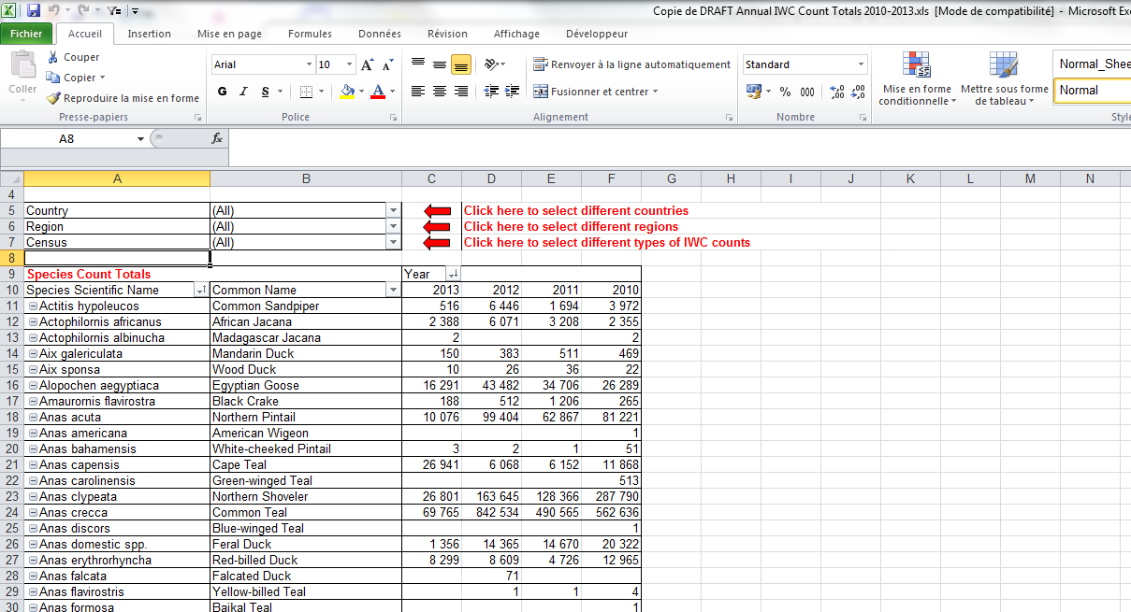
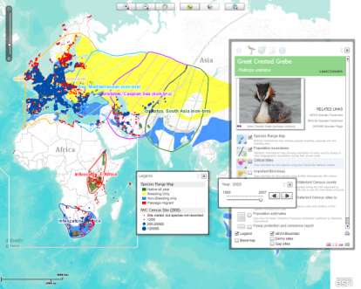
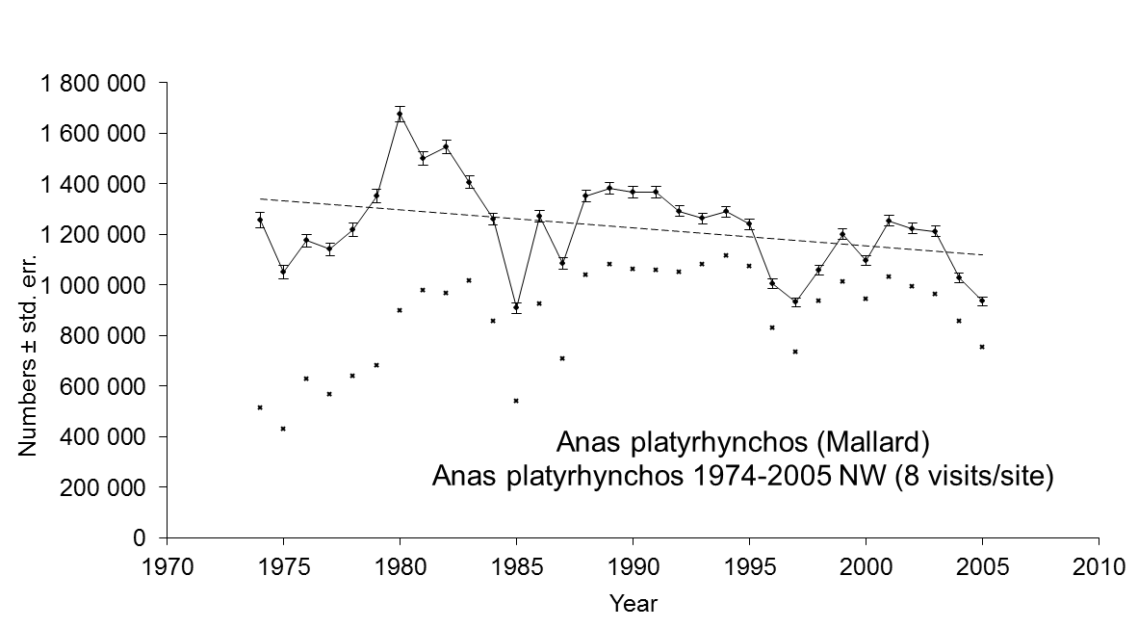
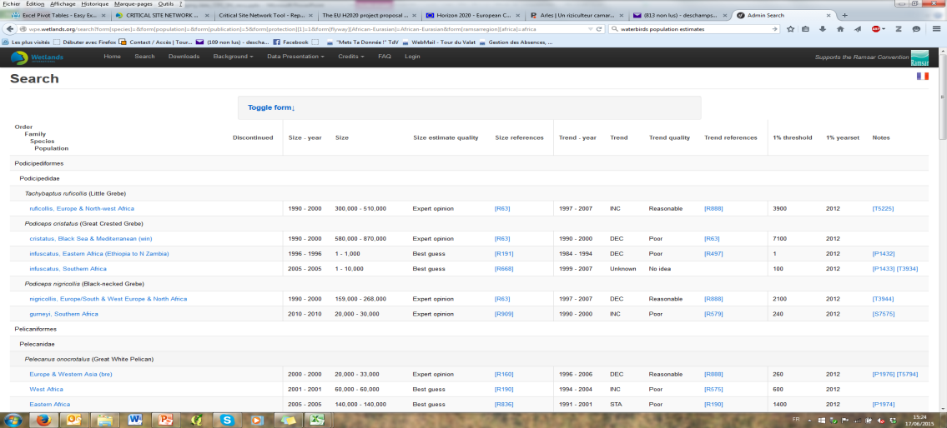
Waterbird Census Data Flow
Step 4: International overviews produced on the basis of IWC data among others
Printed publications
Online resources
Notes:
The trainer will start by asking the trainees to recall the international objectives for waterbird counting from Module 4 or to look them up in the “What are waterbird counts for? The main factors” factsheet S4.1.
On the left side, are examples of traditional paper publications. However, Wetlands International has shifted to disseminate the results online to reach a wider audience, and to accelerate turn-around time between data collection and publication which is an important factor if this data are to be used in management.
There is an annual count total report produced every year: the latest edition can always be found in the Output section of the African-Eurasian Waterbird Census website:(http://www.wetlands.org/AfricanEurasianWaterbirdCensus/Outputs/tabid/3044/Default.aspx)
The Critical Site Network Tool provides access to information on waterbird populations and their key sites (http://dev.unep-wcmc.org/csn/default.html#state=info). It is a very versatile tool and it is worth reading the user guide first which can be downloaded from the Help page.
Wetlands International also produces trend analyses every three years that feed into the AEWA Conservation Status Reports which are presented every 3 years at the Meeting of the Parties to the Agreement on the Conservation of African-Eurasian Migratory Waterbirds (AEWA) and which serve as the basis for adapting the management regimes for waterbird populations (i.e. whether they need strict protection or whether their exploitation is less restricted). The results of such trend analyses are also accessible through the Output section of the African-Eurasian Waterbird Census website: (http://www.wetlands.org/AfricanEurasianWaterbirdCensus/Outputs/tabid/3044/Default.aspx).
The population size and trend estimates and 1% thresholds to be applied under the Ramsar Convention on Wetlands are also accessible through the Waterbird Population Estimates website (http://wpe.wetlands.org/).
If time and Internet access allows, these tools can be demonstrated during the workshop showing how the user can extract management relevant information from them.

Slide 26
How does the International waterbird census help waterbird conservation?
The data provide the basis for assessing changes at site, national and population level.
They serve as the basis for adaption of the management regimes for waterbird populations (i.e. whether they need strict protection or their exploitation is less restricted)
They are used to assess the effectiveness of various conservation measures and instruments.
Notes:
The trainer will explain how the International waterbird census helps waterbird conservation.
He of she might give examples of conservation measures taken for species according to international bird census results, e.g. hunting regulations such as bans, bag limits, period, etc.

Slide 27
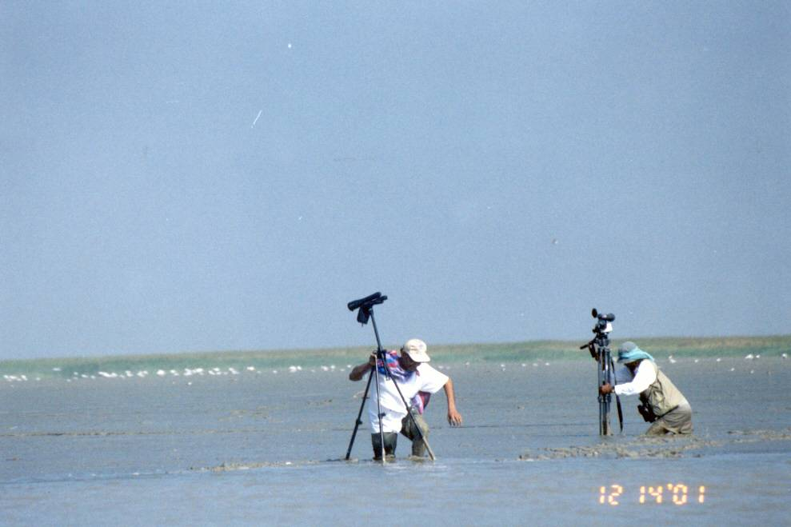
Thank you for your attention!

